Slide 1
Student Performance Prediction
Team 8: Ahmed Hamouda, Xiaowei Wan, Stanley Njiru Kariuki

Slide 2
Part I: Introduction

Slide 3
Introduction
Academic performance has been a standard measure for many countries and academic systems throughout the world. It is used to determine entry into higher institutions, strengths and weaknesses of students, along with directing job placements within certain fields
Grading has long been used as a method to rank student achievement and performance

Slide 4
Related Research
“Factors Contributing to Academic Performance of Students in a Tertiary Institution in Singapore” Farooq, Chaudhry, Shafiq and Berhanu (2011)
Objectives of the study were to determine if factors such as gender, age, nationality of student, part-time employment, extracurricular activities and interest in pursuing higher studies affected academic success.
The students’ cumulative Grade Point Average (cGPA) was used as a measure of academic performance
Results
- Results showed that factors such as gender, nationality of student, co-curricular activities and an interest in pursuing higher degrees affected students’ academic score

Slide 5
Attributes
1. Gender - student's gender (nominal: 'Male' or 'Female’)
2. Nationality - student's nationality
3. Place of birth - student's Place of birth
4. Educational Stages - educational level student belongs
5. Grade Levels - grade student belongs
6. Section ID - classroom student belongs (nominal:’A’,’B’,’C’)
7. Topic - course topic
8. Semester - school year semester (nominal:’ First’,’ Second’)
9. Parent responsible for student (nominal:’mom’,’father’)
10. Raised hand - how many times the student raises his/her hand on classroom
11. Visited resources - how many times the student visits a course content
12. Viewing announcements - how many times the student checks the new announcements
13. Discussion groups - how many times the student participate on discussion groups
14. Parent Answering Survey- parent answered the surveys which are provided from school or not
15. Parent School Satisfaction - the Degree of parent satisfaction from school
16. Student Absence Days - the number of absence days for each student

Slide 6
Part II:
Methodology and results

Slide 7
Methodology
Participants
- The dataset consists of 305 males and 175 females. The students come from different origin. The dataset is collected through two educational semesters
Hypothesis
Student engagement in class and parent collaboration with the school have significant influence on the student’s performance

Slide 8
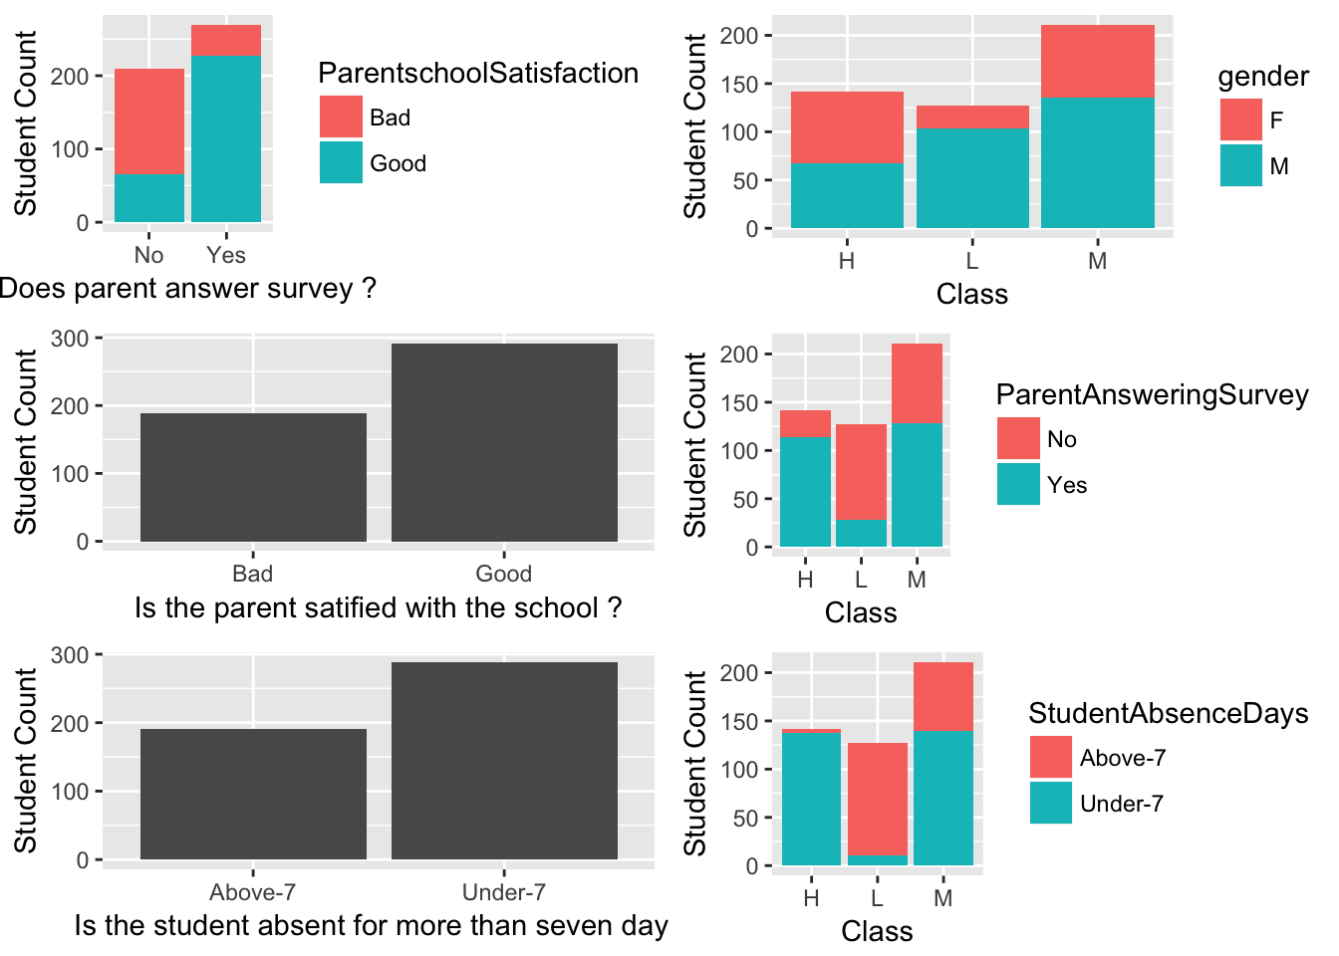
Parent survey, parent satisfaction and guardian data observations

Slide 9
Observations
- Most of the parents who aren’t satisfied with the school do not answer the survey and vice versa.
- The students who have Moms as guardians have higher chances to get high class marks and vice-versa.
- Students whose parents answer the survey are the ones getting good marks and vice-versa.
- Student getting absent are the ones getting low marks and vice-versa.

Slide 10
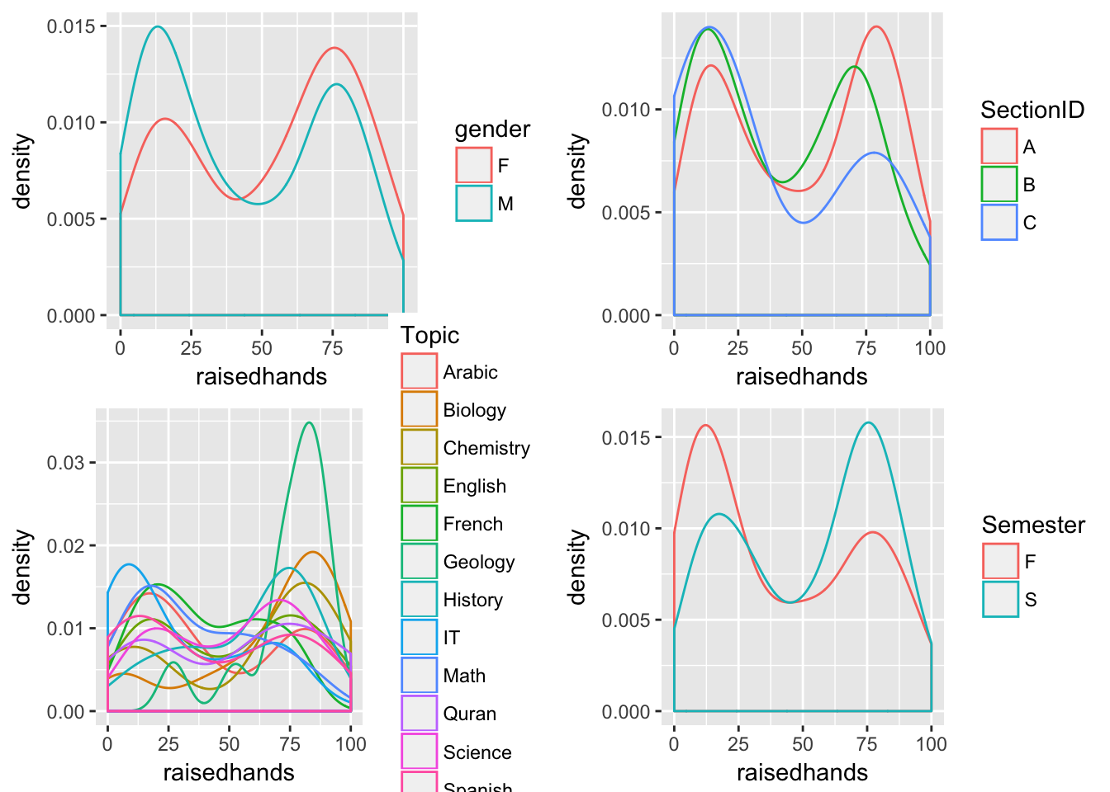
Analysis
- Girls students raised hands more than boys students.
- Students in second semester raised hands more.
- On parent survey answered yes has more hand raises.
- Students with Mom guardian have more hand raises.

Slide 11
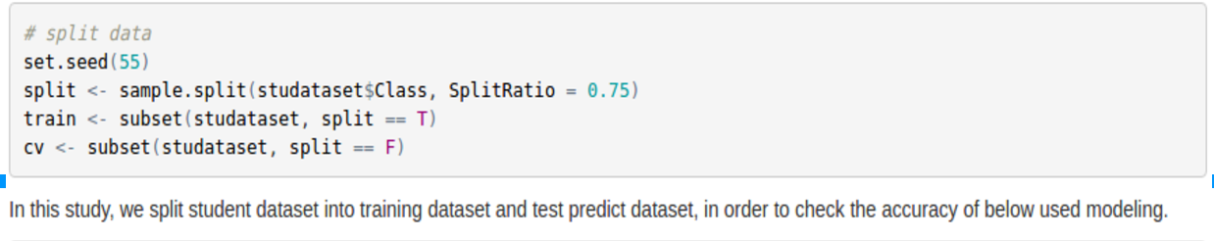
Analysis
Split data into training data and predict for testing

Slide 12
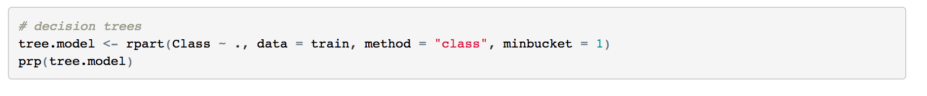
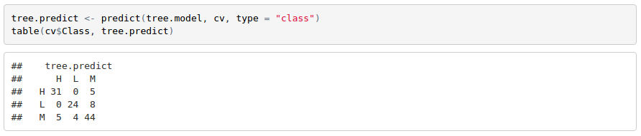
Decision Tree modeling:

Slide 13
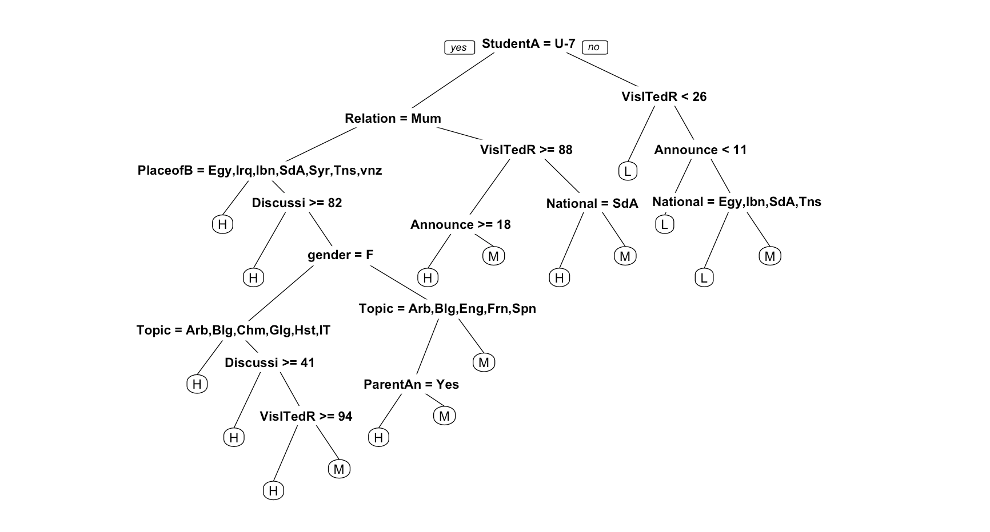
Observations:
From predict results, we can conclude that:
Students who are under 7 years old, and guardian by their Mum, who visited resources greater than or equal 88 times, from Saudi Arabia country, they attend high school or middle school.

Slide 14
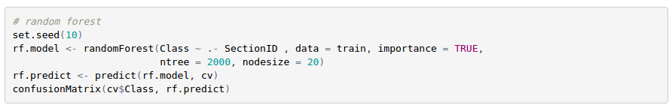
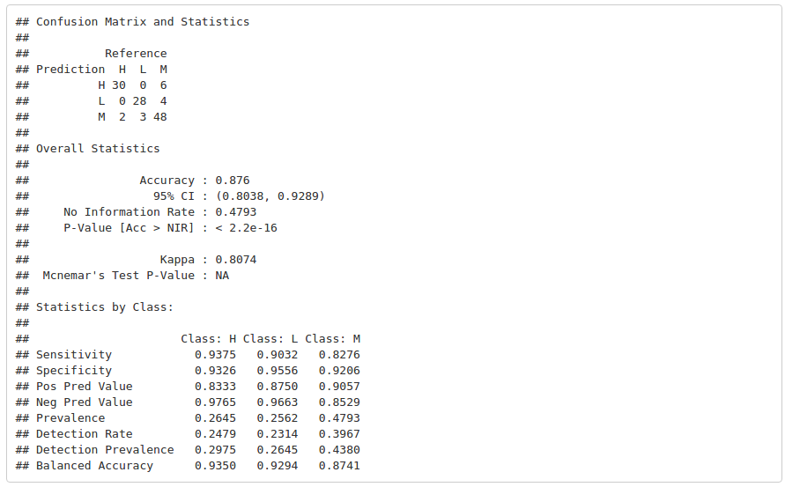
Analysis – random forest modeling

Slide 15
Observations
- Most of the parents who aren’t satisfied with the school do not answer the survey and vice versa.
- The students who have Moms as guardians have higher chances to get high class marks and vice-versa.
- Students whose parents answer the survey are the ones getting good marks and vice-versa.
- Student getting absent are the ones getting low marks and vice-versa.

Slide 16
Part III: Discussion And Conclusion

Slide 17
Discussion
The above study is conducted to observe the factors that can influence student performance. The performance of the student is evaluated as class score, low, middle, or high. In our research, we analyze different factors among students who work good, in the middle, and who have a lower score.
We set up a couple of different categories of factors to conduct the analysis, external, internal and parents’ performance. We know every kid has different talent, from the research we did, we found that generally, girls perform better than boys. It is interesting that, contrary to popular perception, girls perform much better than boys in science class. We believe as our research goes on, we will discover more phenomenon like this, which will make our research more and more interesting.
For the next step, we will focus our study on how active and energetic a student performs in class. We make the following hypothesis:
The more active a student is in the class, the better outcome of the performance they will gain.
The more the parent cooperate with the school, the better performance the student will have.
At the same time, we will focus on the study of the correlations between the various factors. And we will also analyze that among all these different factors, which one has the biggest impact to students’ performance.

Slide 18
Conclusion
We can conclude that: Students whose parents answering survey, and guardian by their mother, and answering survey as yes, students who raised their hand more on class can have better performance. Other factors have smaller effect on students’ performance.

